Slide 1
Complexity Versus Interpretability in Actuarial Assumption Setting
John Brady – Chief Actuary
John Golemba – Senior Actuarial Consultant
May 21, 2024

Slide 2
Agenda
Assumption Setting Actuary’s Perspective
Predictive Modeling 101 – A crash course on regression techniques for assumption setting
Case Study – Setting Variable Annuity lapse rates using Predictive Modeling
Additional dynamic lapse considerations for interest rate risk
Management’s Perspective
Decision whether to use Predictive Modeling
Implementation considerations
Ongoing management of assumptions set using Predictive Modeling

Slide 3
Predictive Modeling 101 What is Predictive Modeling (and What is it Not)?
Predictive Modeling Is…
…the use of statistical methods to identify patterns in data (predictors) that can help project a future event of interest (a target)
…used to better understand how contract and policyholder characteristics influence key policyholder behaviors such as lapse rates, mortality rates, and withdrawal activity
…only reliable when analyzing a sufficiently large set of data over a relevant historical period of time
Predictive Modeling is NOT…
…intended to make definitive predictions about individuals
…intended to be overly complicated and difficult for people to understand
…perfect – all models and assumptions are wrong to a certain degree

Slide 4
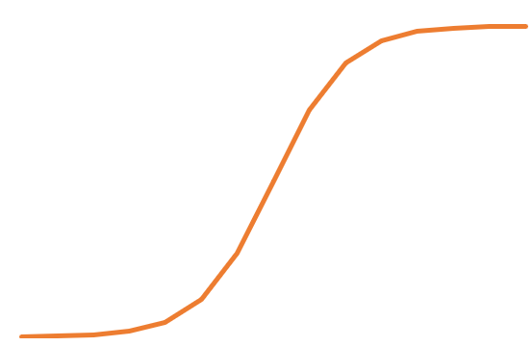
Predictive Modeling 101 Crash Course on Regression
Generalized Linear Model: A formula that expresses the relationship between one dependent variable (the target) and a series of other independent variables (the predictors)
Formula is calibrated such that the error between the target and predictors is minimized
Requires an assumption about the distribution of the target variable
For simple linear regression, this is a line of best fit
Y=1
The modeling of probabilities can be accomplished in many situations by using a logistic regression
$Y=B_{0}+B_{1}∗X_{1}+…+B_{n}∗X_{n}$ (where B’s are coefficients, X’s are predictors, and Y is the target)
Logistic function: $p(Y)=\frac{1}{1+\exp\left(−Y\right)}$
The logistic function is bounded by 0 and 1 so is ideal for deriving assumptions that take the form of probabilities such as lapse rates
Y=0
X
Mortality rates can be modeled starting with an industry mortality table and applying multiplicative adjustments based on the following formula:
Y = Base probability * exp($B_{0}+B_{1}∗X_{1}+…+B_{n}∗X_{n}$ )
= Base probability * exp($B_{0}$) * exp($B_{1}∗X_{1}$) * … * exp($B_{n}∗X_{n}$)

Slide 5
Case Study – Setting a Lapse Assumption Using PM Case Study Overview
A fictious dataset containing monthly policyholder and contract information has been constructed:
Variable | Definition
LAPSE_IND | 1 if a contract lapsed within the month, 0 otherwise
CNTRCT_ID | Numeric contract ID to differentiate records
REPORTING_YRMO | Numeric date in the form “YYYYMM” to differentiate records
SYST_WD_TAKER | “Yes” if a contract is taking regular withdrawals, “No” otherwise
AGE | Attained age of policyholder ranging continuously from 50 to 89
DB_MONEYNESS | Ratio of Account Value to Death Benefit Notional Amount
TIME_SNC_SC_EXPIRY | Time since the expiration of any applicable surrender charges ranging discretely from -1 (before SC expiry) to 10 (10+ years since SC expiry)
WEIGHTS | Maximum of Account Value, Death Benefit Notional, and Withdrawal Benefit Notional
The dataset contains ~6.5M observations and has an average overall lapse rate of 5.75%
Process of constructing a regression formula to predict future lapse probabilities:
Hypothesize which features may be indicative of a contract’s lapse rate and conduct a visual analysis of trends between each feature and observed lapse experience
Construct multiple candidate regression formulas using the logistic function and assess the significance of each modeled predictor
Conduct 10-way holdout testing to identify an optimal regression formula and to determine whether any predictors should be removed
Use all available data to construct the optimal regression formula chosen through 10-way holdout testing
**Disclaimer: This case study does not represent Talcott Financial Group’s data, experience, nor it’s specific approach to setting assumptions

Slide 6
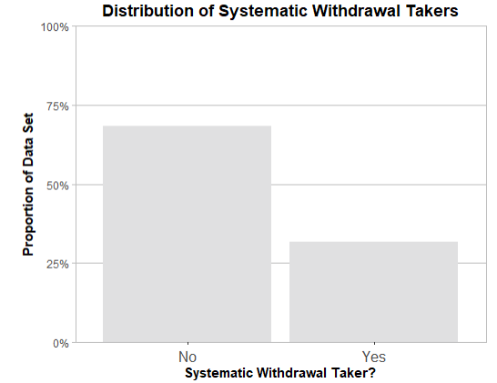
Case Study – Setting a Lapse Assumption Using PM Candidate Variable 1: Systematic WD Behavior
Hypothesis: Policyholders who are taking regular withdrawals are more persistent
Intuition: Policyholders who are taking regular withdrawals are more engaged with their contracts and perceive more value in them
Conclusion: Test a regression model that includes a simple Yes/No indicator for whether a person is taking regular withdrawals

Slide 7
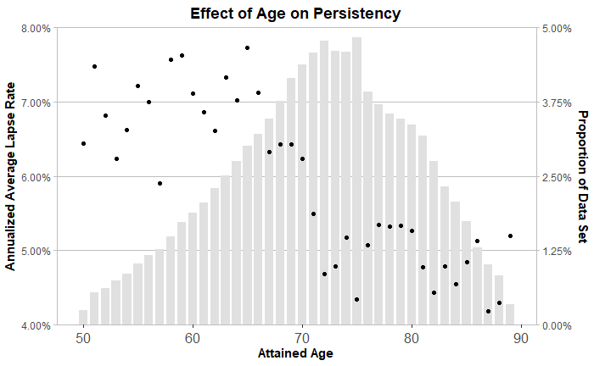
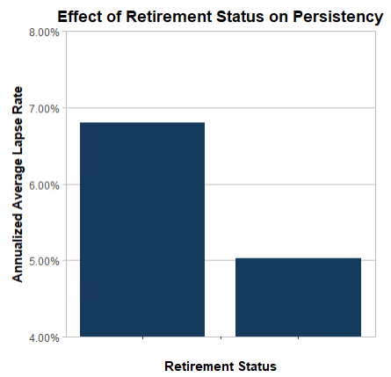
Case Study – Setting a Lapse Assumption Using PM Candidate Variable 2: Attained Age
Hypothesis: Younger policyholders are more persistent than older policyholders
Intuition: People become less passive investors as they approach and subsequently enter retirement
Pre-Retirement Post-Retirement
Conclusion: Test a regression model that includes a simple binary indicator for a policyholder’s retirement status, assuming most policyholders are retired by age 70

Slide 8
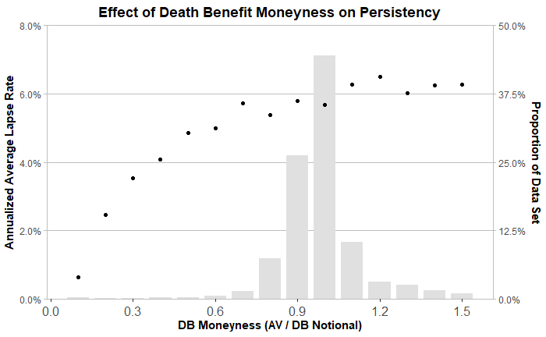
Case Study – Setting a Lapse Assumption Using PM Candidate Variable 3: Moneyness of Death Benefit
Definition: Moneyness = Account Value / Death Benefit Notional
Moneyness > 1 implies a contract is “Out-of-the-Money
Moneyness < 1 implies a contract is “In-the-Money”
Hypothesis: Contracts that are “In-the-Money” are more persistent than contracts that are “Out-of-the-Money”
Intuition: “In-the-Money” contracts are generally perceived to be more valuable
Conclusion: Test a regression model that includes a continuous variable representing the natural logarithm of Death Benefit Moneyness

Slide 9
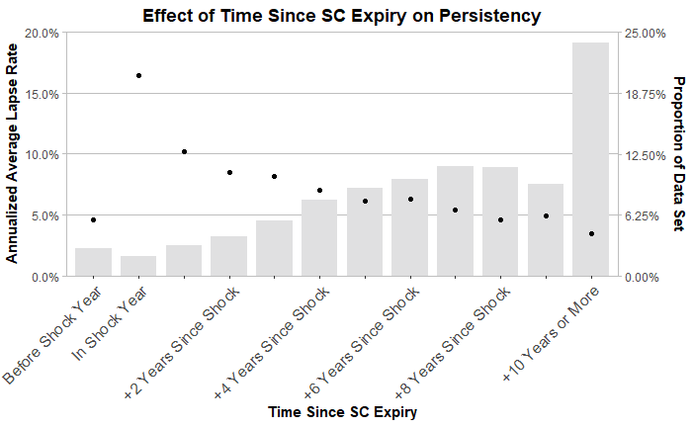
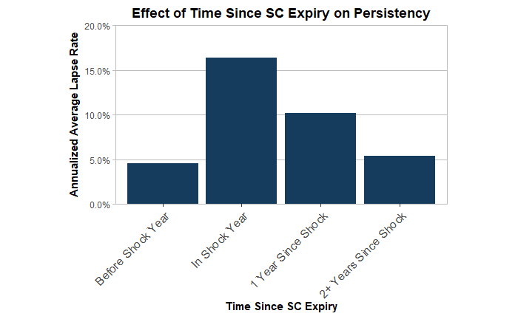
Case Study – Setting a Lapse Assumption Using PM Candidate Variable 4: Time Relative to SC Period Expiry
Hypothesis: Policyholders are most likely to surrender immediately after the surrender charge period expires, and least likely during the surrender charge period. Lapse rates may be moderate in the years following the end of the SC period
Intuition: Policyholders are reluctant to surrender in the presence of SCs but those that would have surrendered without them will leave immediately once they expire
Conclusion: Test two competing models:
Model 1: Consider a decreasing linear trend in lapse rates between 1 and 10 years after the surrender charge period expires
Model 2: Group policyholders into 1 of four buckets to distinguish being in the SC period, being 0-1 years, 1-2 years, or 2+ years after the SC period expires

Slide 10
Case Study – Setting a Lapse Assumption Using PM Initial Regression Results
Two regression formulas have been proposed with the following features:
Predictor | Model 1 | Model 2
Systematic WD Taker | Binary Yes/No indicator | Binary Yes/No indicator
Retirement Indicator | Binary Pre/Post Retirement indicator (split at age 70) | Binary Pre/Post Retirement indicator (split at age 70)
DB Moneyness | LN(DB Moneyness) | LN(DB Moneyness)
Time Relative to SC Expiry | Consider 4 Categorical Groups: - Before SC Expiry - In Shock Year - 1 Year After Shock Year - 2+ Years After Shock Year | Consider 2 Categorical Groups: - Before SC Expiry - In Shock Year And a decreasing linear trend for 1 – 10 years after the shock year
{
Model 1: Preliminary Results
{
Model 2: Preliminary Results

Slide 11
Case Study – Setting a Lapse Assumption Using PM 10-Way Holdout Testing Algorithm
Testing is required to assess how well the chosen regression formula performs on unseen data
Two simple ways to assess the performance of a model:
Root Mean Squared Error = $\sqrt{\frac{\sum{w_{i}{({\hat{x}}_{i}−x_{i})}^{2}}}{\sum{w_{i}}}}$
Akaike’s Information Criterion = 2n - 2ln(L),
where L = Likelihood Function
and n = Number of Model Parameters
The algorithm works as follows:
The data is split into ten representative subgroups based on the last digit of the contract numbers
Nine subgroups are used to train a regression model with the chosen predictors, and the remaining subgroup is used to test the predictive accuracy of the model using RMSE and AIC
This is repeated ten times, once for each subgroup
Holdout testing can help identify an optimal regression model by comparing the RMSE and AIC between two or more candidate models,
E.g., a model with all potential predictors included and a model with one of those predictors removed
E.g., two models with different versions of a predictor (for example, two possible groupings of rider type)
For a candidate model to win over another comparative model, we will subjectively require that it pass at least 8 out of the 10 holdout tests on both a RMSE and AIC basis
Evaluates the goodness-of-fit of a model by taking the square root of the weighted average squared differences between actual observations and the regression predictions
Evaluates the trade off between the goodness-of-fit and the complexity of the model by penalizing models according to the number of parameters (predictors) they have

Slide 12
Case Study – Setting a Lapse Assumption Using PM Holdout Test 1: Assess Competing Models
The following contain the holdout testing results after comparing Models 1 and 2
RMSE:
Model 1
Model 2
AIC:
Model 1
Model 2
The results suggest proceeding with Model 2

Slide 13
Case Study – Setting a Lapse Assumption Using PM Holdout Test 2: Assessment of the Retirement Feature
The following contain the holdout testing results for Model 2 with all proposed features, and with the Retirement Indicator removed
RMSE:
AIC:
The results suggest removing the Retirement Indicator from the Model

Slide 14
Case Study – Setting a Lapse Assumption Using PM Final Model Proposal
Subsequent holdout tests confirmed that all features except for the Retirement Indicator should remain in the regression formula
The final regression model is of the following form:
B₀ +
B₁ * 1{SYST_WD_TAKER = 1} +
B₂ * LN(DB_MONEYNESS) +
B₃ * 1{In SC Period = 1} +
B₄ * 1{In Shock Lapse Year = 1} +
B₅ * 1{Past Shock Lapse Year = 1} * Number of Years Since Shock Year
$p\left(Y\right)=\frac{1}{1+\exp\left(−Y\right)}$ ;
Where Y =
B₀:
B₁:
B₂:
B₃:
B₄:
B₅:
Example: Suppose a contract has the following characteristics:
The Policyholder is Age 68 and is a Systematic WD Taker
The contract has an Account Value of 100,000, a DB Notional of 110,000, and is 5 years past the end of the SC period
The probability of lapsing is calculated as follows:
Y = -4.3569 – 0.6459*1 + 0.5749*LN(0.9091) – 0.9871*0 + 0.3719*0 – 0.1239*5 = -5.6771
P = $\frac{1}{1+\exp\left(5.6771\right)}$ = 0.003412
Annualizing this gives a predicted lapse rate of 4.02%
If AV increases to 110,000, DB Moneyness will increase to 1.00 and the annualized lapse rate will increase to 4.24%

Slide 15
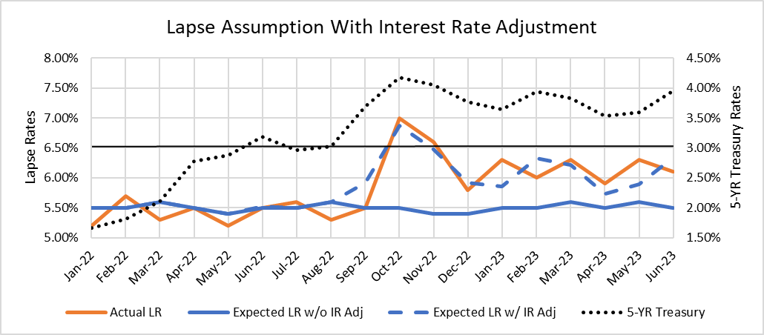
Additional Consideration – Interest Rates Incorporating Interest Rates into Dynamic Lapse Formula
Consider a fictitious Variable Annuity product that is primarily invested in a General Account of fixed income bonds and has a guaranteed crediting rate of 3% per year
The following is a standard additive adjustment that can be layered on top of the output of a predictive model to increase the expected lapse rates if the chosen reference rate surpasses the crediting rate:
Adj = +${100∗Z∗(MR −CR)}^{K}$ where MR > CR
This VA has the following lapse experience – the lapse assumption was updated to include an interest rate adjustment with Z = 1, K=2, and a reference rate equal to the 5-Year US Treasury
**Disclaimer: This example does not represent Talcott Financial Group’s data, experience, nor it’s specific approach to setting assumptions

Slide 16
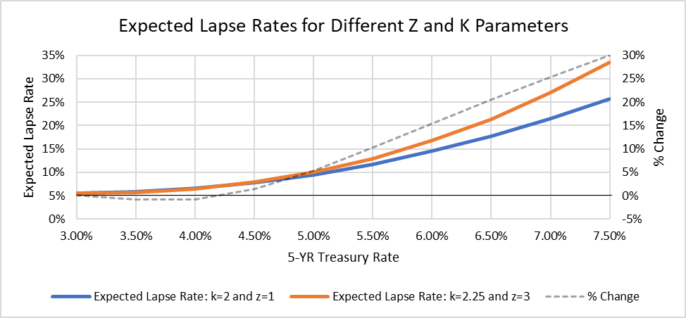
Additional Consideration – Interest Rates Accounting for Unprecedented Interest Rate Levels
Care must be taken in setting the Z and K parameters since their values can cause the formula to have differing degrees of sensitivity to changes in interest rates
For example, using Z=1 and K=2, or Z=3 and K=2.25, give similar results when interest rates are below 5%
If interest rates rise above 5% however, the expected lapse rates from the formula become noticeably more different
It is important to form an opinion about lapse behavior at rate levels that are yet to be seen to help inform how to calibrate the adjustment

Slide 17
Final Remarks from the Perspective of the Assumption Setting Actuary
Predictive modeling is a useful tool that can be used to systematically identify contract and policyholder characteristics that influence key policyholder behaviors such as lapse, mortality, and withdrawal taking trends that are important for modeling, projections, and valuation.
It is important to keep in mind that the relative complexity underlying such approaches can be a barrier to management’s ability to understand, interpret, and gain comfort with proposed assumptions
The top priority of the assumption setting actuary should be to develop a regression formula that can be justified by intuition and straightforward calculations
Develop a hypothesis for which features are predictive of the target behavior
Rationalize the influence each feature should have on the target behavior prior to performing any analysis
Leverage visual aids such as graphs to demonstrate trends in the data that prove or disprove the hypothesis and our intuition – this can also serve as a useful control for data validation purposes
Choose a regression formula that is easy to explain to management and has intuitive appeal
Any adjustments to the assumption outside of the predictive model (i.e. additional interest rate terms) should also be intuitive, but care should be taken due to the subjectivity and potential lack of available data available to inform the adjustments

Slide 18
Predictive Modeling Considerations from Management Perspective
Key considerations for management regarding the adoption of predictive modeling techniques for assumption setting
Decision: Should we use predictive modeling?
Implementation: We decided to use predictive modeling, now what?
Ongoing Management: We implemented, now what?
Other considerations

Slide 19
Predictive Modeling – Management Considerations: Decision to Use Predictive Modeling
Decision: Should we use predictive modeling?
Pros / Cons relative to alternative
Assessing landscape
Organizational interest
Talent assessment
Communication with senior leaders

Slide 20
Predictive Modeling – Management Considerations: Decision to Use Predictive Modeling
Communication to senior management – example of information shared:
Moving to a predictive modeling approach for key behavior assumptions has several advantages over traditional approaches
More efficient:
Formulas optimize the best fit of parameters, replacing manual adjustments
The number of parameters is reduced vs previously used tables
Analyzing possible additional factors is straightforward
Databases from predictive modeling are available for other analysis
More accurate:
More factors and relationships between factors can be tested
Results can be statistically shown to be predictive, rather than overfitting the data
Identifying which contracts will lapse (or step up or take partial withdrawals) can be as important at the aggregate level, as the financial impact varies by contract
The accuracy of assumptions can be better analyzed as experience emerges

Slide 21
Predictive Modeling – Management Considerations: Implementation of Predictive Modeling Techniques
Implementation: We decided to use predictive modeling, now what?
Scope – e.g., lapse only or other assumptions? How many products?
In 2019 Talcott started with VA lapses and withdrawal benefit utilization
Controls & governance
Ongoing data quality control
Data comparisons to other departments (e.g., lapse counts from accounting reports)
Checks for data anomalies (e.g., a contract lapsed and then reappeared in the inforce file in the next month
Formal peer review of code used to set assumptions
Reproducing calculations in Excel
Model output vs Actuarial judgement
Initial predictive model for VA lapses used all the same parameters used in the past
One field was modified – policy duration to policyholder attained age
Two fields were added out of many considered based on several factors
Setting margins
Communication of impact

Slide 22
Predictive Modeling – Management Considerations: Ongoing Management of Assumptions
Ongoing Management: We implemented, now what?
Tracking actual vs expected experience
Adhoc analysis when experience begins to deviate from expected due to external circumstances
Scope – additional assumptions and/or products
In 2019 Talcott started with VA lapses and withdrawal benefit utilization
Today its expanded to lapse and mortality assumptions across multiple blocks of business
Some assumptions that were originally identified as good candidates for predictive modeling have not been implemented. For example, decisions at ACD – usually age 90 or later, so limited data & limited impact
Updating existing parameters for latest experience
Changes to the number of parameters
Changes to the complexity of approach
Changes to which employees are involved

Slide 23
Predictive Modeling – Management Considerations: Other Considerations
Other considerations
M&A / reinsurance
Communication to external constituents
Weighting data

Slide 24
Final Considerations
Predictive modeling is powerful but complex
Technical knowledge & expertise is needed
Technical & managerial oversight is needed
Assumption setting actuary needs to be able to communicate technical concepts & methods to people with varying degrees of background, both actuarial & non-actuarial
A balance of actuarial science & actuarial judgement is critical
Experience is evolving over time – it is important to keep up and adapt regularly

