Slide 1
The Revised S&P Global Insurance Capital Model
Presented by
Spencer Ackerman, FSA, MAAA
May 21, 2024
Notes:
Good afternoon I’m
Add name
Published

Slide 2
About this Presentation
About Delaware Life
Founded in 2013, Delaware Life Insurance Company is a member of Group 1001, a collective that empowers companies to create positive growth
Active seller of retirement products (MYGA, FIA and VA)
About my role at Delaware Life
Responsible for internal capital modeling, forecasting, reporting and analysis for NAIC RBC, AM Best and S&P
Focus of presentation
Actively sold products and investments
Statutory NAIC perspective
Views are my own and do not reflect those of Group 1001 or Delaware Life
Part of L&A business unit, but also support P&C and other corporate capital initiatives
Lead a cross departmental effort to fill out and submit the new capital model inputs
Cross capital perspective between NAIC RBC, AM Best and S&P
Rated by AM Best, S&P and Fitch
Subsidiary Clear Spring Property & Casualty actively sells Workers Comp, General Liability, and Select Auto
Worked with our rating analysts to assist their review of our results under the new criteria
Notes:
Group 1001 is a Group 1001 is a collective that empowers companies to create positive growth. Our insurance and annuities are easy to understand and accessible to all. Our online investing platform gives individuals control over their savings. Our technology and innovation help companies succeed. And our strategic partnerships bring people together through education and sports.Delaware Life
Rated by AM Best (A-), S&P (BBB+) and Fitch (A-)
Actively sells MYGA, FIA and VA
Subsidiary Clear Spring Property & Casualty sells P&C insurance with focus on Worker Comp
My team is responsible for modeling and reporting of NAIC RBC, AM Best and S&P capital models

Slide 3
Agenda
General Background
Timeline of Capital Model Development
Structural Changes of Capital Model
Deep Dive into Selected Topics
Investment Risks
Liability and Interest Rate Risks
Diversification
Q&A

Slide 4
S&P Global Insurance Capital Model Timeline
2010
05-2022
05-2023
12-2021
Last major overhaul to S&P insurance capital model
S&P issues initial RFC publication
S&P announces intention to issue a subsequent RfC
11-2023
04-2024
S&P provides update - 63 issuers taken off UCO list, 60% of rated issuers have been reviewed under revised criteria
Revised RfC guidance issued
Revised capital model adopted - 63 issuer ratings placed under criteria observation (UCO)
Notes:
All rating changes were limited to one notch and we saw more upgrades than downgrades. We took positive rating actions on 62% of issuers identified as UCO; these were primarily driven by higher levels of available capital and more explicitly capturing the benefits of risk diversification under the revised criteria.
We took negative rating actions on 8% of issuers identified as UCO; these primarily related to our revised definition of capital resources, which reduced the basis for determining the amount of debt-funded capital for some issuers.

Slide 5
General Changes to Capital Model
“RBC requirements are the amounts of capital in excess of reserves that an insurance company may need to cover losses from different risks in stress scenarios.” – S&P Insurer Risk Based Capital Criteria
Changes from prior model
New risk scenario levels that are no longer
described with a specific rating
New factors and inputs for everything
Completely new diversification credit
Goal of global consistency
Accounting agnostic inputs that require interpretation
Inputs are almost entirely provided from company records
Similarities with prior model
Transparent capital model provided to insurer
Primary metric is redundancy in both absolute dollars and as a percent of required capital
Risk Scenario | New Model VaR Level | Prior Model Mapped Level
Moderate Stress | 99.5% | BBB
Substantial Stress | 99.8% | A
Severe Stress | 99.95% | AA
Extreme Stress | 99.99% | AAA

Slide 6
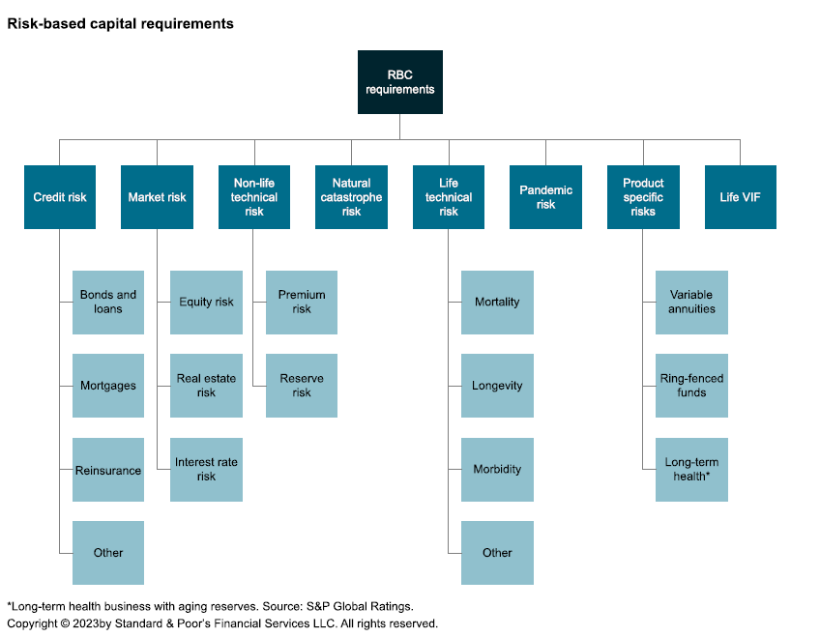
General Changes to Capital Model
New risk categories replacing C1, C2, C3 and C4 categories
Risk categories get 2-3 levels of diversification, one level within risk categories, and between risk categories
Notes:
Complicated calculation
Three levels of diversification
Covariance factors by multiple risk categories
Haircut on aggregate diversification
Material update to model, especially compared to prior model
Compare against NAIC RBC and AM Best - Major Differences
Complexity
VA gets no diversification treatment
P&C is included
Similarities
Significant diversification for non-VA liability risks (mortality, longevity, reserve risks)
Need to allocate diversification back to risk drivers for capital analysis

Slide 7
Investment Risk
Section 2

Slide 8
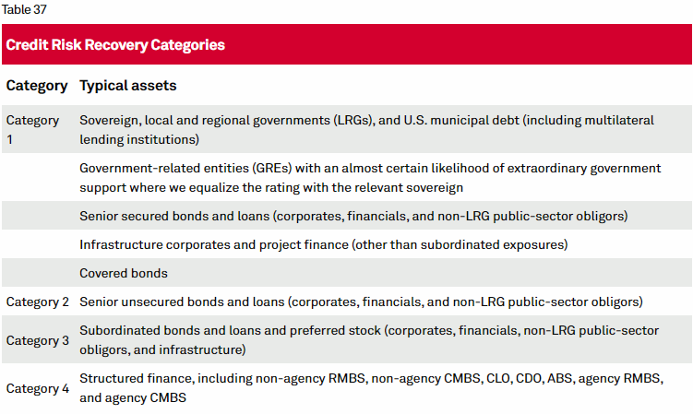
Investment Risks Changes against prior model
Bond risk charges now vary by recovery category
Credit Rating waterfall selection
Accounting regime agnostic (talk about unrated treatment)
All of these changes require a new data process for insurers
Notes:
Rating selection process
Recovery category mapping
Need to maintain a new dataset, will require an investment in a data process for pulling the relevant fields from your investment management and accounting system for maintaining both the new data
Talk about

Slide 9
Investment Risks Changes against prior model
Step 1 - Rated by S&P Use S&P Rating
Step 2 - Rated by Other Regulatory Approved CRA Use Worst CRA Rating
Step 3 - Rated by Regulator Use Regulatory Rating
Step 4 – Unrated uses a Mapped Rating based on Sector
Bond risk charges now vary by recovery category
Credit Rating follows a waterfall selection process
Notes:
Rating selection process
Recovery category mapping
Need to maintain a new dataset, will require an investment in a data process for pulling the relevant fields from your investment management and accounting system for maintaining both the new data
Talk about

Slide 10
Investment Risks Changes against prior model
Step 1 - Rated by S&P Use S&P Rating
Step 2 - Rated by Other Regulatory Approved CRA Use Worst CRA Rating
Step 3 - Rated by Regulator Use Regulatory Rating
Step 4 – Unrated uses a Mapped Rating based on Sector
Bond risk charges now vary by recovery category
Credit Rating follows a waterfall selection process
Designed to be agnostic to the accounting regime
Requires a significant effort in pulling the relevant data from your investment management and accounting system
Notes:
Rating selection process
Recovery category mapping
Need to maintain a new dataset, will require an investment in a data process for pulling the relevant fields from your investment management and accounting system for maintaining both the new data
Talk about

Slide 11
Investment Risks S&P VaR 99.95% less Current AA Factor Differences – excluding Recovery Category 4

Slide 12
Investment Risks Changes against prior model
Illustrative Portfolio Example composed of 90% Bonds (70% IG, 20% BIG), 6% Equity, 4% Cash
Category | YTM | Rating | % | S&P VaR 99.95% | S&P AA | Model Impact
Bond - IG Structured | 5 Yrs | A | 10% | 1.7% | 1.2% | 0.5%
Bond - BIG Structured | 5 Yrs | BB | 5% | 12.3% | 20.0% | -7.7%
Bond - IG Unsecured | 5 Yrs | BBB | 30% | 2.5% | 2.5% | 0.0%
Bond - IG Secured | 5 Yrs | BBB | 30% | 1.4% | 2.5% | -1.2%
Bond - BIG Secured | 5 Yrs | BB | 15% | 3.7% | 11.0% | -7.3%
Residual Equity | 5 Yrs |  | 1% | 100.0% | 42.0% | 58.0%
Private Common Stock |  |  | 5% | 60.0% | 42.0% | 18.0%
Cash |  |  | 4% | 0.2% | 0.1% | 0.1%
Total |  |  | 100% | 6.5% | 6.8% | -0.3%

Slide 13
Investment Risks Cross Model Comparison
Example compared to AM Best (BCAR) and NAIC RBC (at 400% Target)
No diversification credit reflected
BCAR model does not reflect ESG or High Risk CMO adjustments
RBC does not reflect Bond Size Factor adjustments
Category | YTM | Rating | % | S&P VaR 99.95% | BCAR VaR 99.6% | Diff BCAR | RBC 400% CAL | Diff RBC
Bond - IG Structured | 5 Yrs | A | 10% | 1.7% | 2.4% | -0.7% | 2.7% | -1.0%
Bond - BIG Structured | 5 Yrs | BB | 5% | 12.3% | 10.7% | 1.7% | 15.1% | -2.8%
Bond - IG Unsecured | 5 Yrs | BBB | 30% | 2.5% | 5.1% | -2.6% | 2.7% | -0.2%
Bond - IG Secured | 5 Yrs | BBB | 30% | 1.4% | 5.1% | -3.8% | 2.7% | -1.4%
Bond - BIG Secured | 5 Yrs | BB | 15% | 3.7% | 10.7% | -6.9% | 15.1% | -11.4%
Residual Equity | 5 Yrs |  | 1% | 100.0% | 48.4% | 51.6% | 142.2% | -42.2%
Private Common Stock |  |  | 5% | 60.0% | 55.0% | 5.0% | 94.8% | -34.8%
Cash |  |  | 4% | 0.2% | 0% | -0.1% | 1.3% | -1.1%
Total |  |  | 100% | 6.5% | 8.7% | -2.2% | 11.1% | -4.6%
Notes:
Observations:
Higher for BIG structured and preferred stock, lower for all others bonds
Higher for Equity
BIG bond factors significant reductions
Significant increase in Common Stock factors – will be offset in diversificatoin
Huge increase in Residual equity factor

Slide 14
Liability and Interest Rate Risks
Section 3

Slide 15
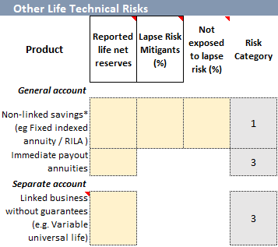
Life Risks – Other Life Technical
Original C3 and C4 risk charges broken into targeted risk charges on interest rate, longevity, and ‘other life technical risk’ (lapse risk)
Other Life Technical Risk varies by three risk categories
1. Lapse risk without mitigants – 2.0%
2. Lapse risk with mitigants – 1.0%
3. No lapse risk of 0.6%
Category 3 – ‘No Lapse Risk’ has a risk charge meant to cover operating expense risk
Notes:
New capital model breaks out C3 and C4 risk charges into targeted risk charges on interest rate, longevity, and ‘other life technical risk’ which covers lapse and expense risk
Other Life Technical Risk varies by three categories
1. Lapse risk without mitigants – 2.0%
2. Lapse risk with mitigants – 1.0%
3. No lapse risk of 0.6%
No lapse risk applies to separate account assets too not covered in Product Specific charges (i.e. VUL)
Longevity Risk varies by three categories
1. High longevity risk - products with no or limited lump-sum optionality for policyholders (e.g. immediate annuities, check with Akram)
2. Medium Longevity Risk – products with economically attractive annuitization options that may or may not be utilized by the policyholder, assumes 30% of policyholders annuitize
3. Low Longevity Risk – products with economically unattractive annuitization options, no risk charge
Longevity risk is scaled down by the accounting regime that reserves are reported on, though no guidance is given as to which regimes get which treatment
Interest rate risk charges are captured in other section, and if elected will be driven by duration modeling results instead of reserves

Slide 16
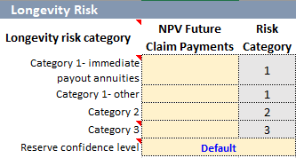
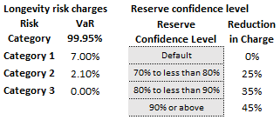
Life Risks - Longevity
Longevity Risk varies by three categories
High risk Products with no or limited lump-sum optionality for policyholders (e.g. SPIA)
Medium Risk Products with economically attractive annuitization options that may or may not be utilized by the policyholder, assumes 30% of policyholders annuitize (e.g. Deferred Annuities with rich annuitization options)
Low Risk (no risk charge) Immaterial longevity risk due to economically unattractive annuitization options
Risk charge is scaled down when reserves for products exposed to longevity risk are held significantly above ‘best estimate’ levels
Notes:
New capital model breaks out C3 and C4 risk charges into targeted risk charges on interest rate, longevity, and ‘other life technical risk’ which covers lapse and expense risk
Other Life Technical Risk varies by three categories
1. Lapse risk without mitigants – 2.0%
2. Lapse risk with mitigants – 1.0%
3. No lapse risk of 0.6%
No lapse risk applies to separate account assets too not covered in Product Specific charges (i.e. VUL)
Longevity Risk varies by three categories
1. High longevity risk - products with no or limited lump-sum optionality for policyholders (e.g. immediate annuities, check with Akram)
2. Medium Longevity Risk – products with economically attractive annuitization options that may or may not be utilized by the policyholder, assumes 30% of policyholders annuitize
3. Low Longevity Risk – products with economically unattractive annuitization options, no risk charge
Longevity risk is scaled down by the accounting regime that reserves are reported on, though no guidance is given as to which regimes get which treatment
Interest rate risk charges are captured in other section, and if elected will be driven by duration modeling results instead of reserves

Slide 17
Life Risks – Illustrative Example
Below are the prior S&P capital model C3 and C4 risk charges for select products. How will the new model impact liability risk charges on select product types?
Product Type | C3 | C4 | Total Old Model | VaR 99.95% | Impact
Full MVAs with surrender charge | 3.90% | 0.20% | 4.10% | ? | ?
No MVAs without surrender charge | 4.10% | 0.20% | 4.30% | ? | ?
Retail SPIAs with life contingencies | 3.50% | 0.20% | 3.70% | ? | ?
Retail SPIAs without life contingencies | 2.80% | 0.20% | 3.00% | ? | ?
Linked business without guarantees (e.g. Variable universal life) | 0.00% | 0.00% | 0.00% | ? | ?
Notes:
New capital model breaks out C3 and C4 risk charges into targeted risk charges on interest rate, longevity, and ‘other life technical risk’ which covers lapse and expense risk
Other Life Technical Risk varies by three categories
1. Lapse risk without mitigants – 2.0%
2. Lapse risk with mitigants – 1.0%
3. No lapse risk of 0.6%
No lapse risk applies to separate account assets too not covered in Product Specific charges (i.e. VUL)
Longevity Risk varies by three categories
1. High longevity risk - products with no or limited lump-sum optionality for policyholders (e.g. immediate annuities, check with Akram)
2. Medium Longevity Risk – products with economically attractive annuitization options that may or may not be utilized by the policyholder, assumes 30% of policyholders annuitize
3. Low Longevity Risk – products with economically unattractive annuitization options, no risk charge
Longevity risk is scaled down by the accounting regime that reserves are reported on, though no guidance is given as to which regimes get which treatment
Interest rate risk charges are captured in other section, and if elected will be driven by duration modeling results instead of reserves

Slide 18
Life Risks – Illustrative Example
Illustrative Example Assumptions
Longevity reserves at highest confidence level (45% reduction in risk charge)
No ALM credit reflected in interest rate risk charge (can be reduced up to 50%)
Deferred Annuities have economically attractive annuitization options
Product Type | Risk Category |  |  | Risk Charge Pre Divers.
 | Interest Rate Risk | Longev. Risk | Lapse Risk | Interest Rate Risk | Longev. Risk | Lapse Risk | Total
Full MVAs with surrender charge | Applies | 2 | 2 | 3.30% | 0.45% | 1.00% | 4.75%
No MVAs without surrender charge | Applies | 2 | 1 | 3.30% | 0.45% | 2.00% | 5.75%
Retail SPIAs with life contingencies | Applies | 1 | 3 | 3.30% | 0.90% | 0.60% | 4.80%
Retail SPIAs without life contingencies | Applies | 3 | 3 | 3.30% | 0.00% | 0.60% | 3.90%
Linked business without guarantees (e.g. Variable universal life) | NA | 3 | 3 | 0.00% | 0.00% | 0.60% | 0.60%
Notes:
New capital model breaks out C3 and C4 risk charges into targeted risk charges on interest rate, longevity, and ‘other life technical risk’ which covers lapse and expense risk
Other Life Technical Risk varies by three categories
1. Lapse risk without mitigants – 2.0%
2. Lapse risk with mitigants – 1.0%
3. No lapse risk of 0.6%
No lapse risk applies to separate account assets too not covered in Product Specific charges (i.e. VUL)
Longevity Risk varies by three categories
1. High longevity risk - products with no or limited lump-sum optionality for policyholders (e.g. immediate annuities, check with Akram)
2. Medium Longevity Risk – products with economically attractive annuitization options that may or may not be utilized by the policyholder, assumes 30% of policyholders annuitize
3. Low Longevity Risk – products with economically unattractive annuitization options, no risk charge
Longevity risk is scaled down by the accounting regime that reserves are reported on, though no guidance is given as to which regimes get which treatment
Interest rate risk charges are captured in other section, and if elected will be driven by duration modeling results instead of reserves

Slide 19
Life Risks - Illustrative Example
Illustrative Example Assumptions continued
Include diversification credit in the analysis
Diversification Factor | 91% | 40% | 50%
Product Type | Interest Rate Risk | Longev. Risk | Lapse Risk | Divers Credit | Total
Full MVAs with surrender charge | 3.30% | 0.45% | 1.00% | -1.08% | 3.67%
No MVAs without surrender charge | 3.30% | 0.45% | 2.00% | -1.58% | 4.17%
Retail SPIAs with life contingencies | 3.30% | 0.90% | 0.60% | -1.15% | 3.65%
Retail SPIAs without life contingencies | 3.30% | 0.13% | 0.60% | -0.69% | 3.34%
Linked business without guarantees (e.g. Variable universal life) | 0.00% | 0.00% | 0.60% | -0.30% | 0.30%
Notes:
New capital model breaks out C3 and C4 risk charges into targeted risk charges on interest rate, longevity, and ‘other life technical risk’ which covers lapse and expense risk
Other Life Technical Risk varies by three categories
1. Lapse risk without mitigants – 2.0%
2. Lapse risk with mitigants – 1.0%
3. No lapse risk of 0.6%
No lapse risk applies to separate account assets too not covered in Product Specific charges (i.e. VUL)
Longevity Risk varies by three categories
1. High longevity risk - products with no or limited lump-sum optionality for policyholders (e.g. immediate annuities, check with Akram)
2. Medium Longevity Risk – products with economically attractive annuitization options that may or may not be utilized by the policyholder, assumes 30% of policyholders annuitize
3. Low Longevity Risk – products with economically unattractive annuitization options, no risk charge
Longevity risk is scaled down by the accounting regime that reserves are reported on, though no guidance is given as to which regimes get which treatment
Interest rate risk charges are captured in other section, and if elected will be driven by duration modeling results instead of reserves

Slide 20
Life Risks - Illustrative Example
Illustrative Example compared to prior S&P model
Reduced capital charges in most product types
Further reductions possible based on ALM credit
Product Type | AA | VaR 99.95% | Impact
Full MVAs with surrender charge | 4.10% | 3.67% | -0.43%
No MVAs without surrender charge | 4.30% | 4.17% | -0.13%
Retail SPIAs with life contingencies | 3.70% | 3.65% | -0.05%
Retail SPIAs without life contingencies | 3.00% | 3.29% | 0.29%
Linked business without guarantees (e.g. Variable universal life) | 0.00% | 0.30% | 0.30%
Notes:
New capital model breaks out C3 and C4 risk charges into targeted risk charges on interest rate, longevity, and ‘other life technical risk’ which covers lapse and expense risk
Other Life Technical Risk varies by three categories
1. Lapse risk without mitigants – 2.0%
2. Lapse risk with mitigants – 1.0%
3. No lapse risk of 0.6%
No lapse risk applies to separate account assets too not covered in Product Specific charges (i.e. VUL)
Longevity Risk varies by three categories
1. High longevity risk - products with no or limited lump-sum optionality for policyholders (e.g. immediate annuities, check with Akram)
2. Medium Longevity Risk – products with economically attractive annuitization options that may or may not be utilized by the policyholder, assumes 30% of policyholders annuitize
3. Low Longevity Risk – products with economically unattractive annuitization options, no risk charge
Longevity risk is scaled down by the accounting regime that reserves are reported on, though no guidance is given as to which regimes get which treatment
Interest rate risk charges are captured in other section, and if elected will be driven by duration modeling results instead of reserves

Slide 21
Life Risks – Illustrative Example
Illustrative Example compared to AM Best and NAIC RBC equivalent C3 + C4 charges
Assumptions
RBC assumes a 50% diversification credit for longevity risk and a 50% credit for C3P1 testing
BCAR assumes a well ALM matched portfolio
Product Type | S&P VaR 99.95% | BCAR VaR 99.6% | RBC 400% CAL | Diff BCAR | Diff RBC
Full MVAs with surrender charge expiring in 2-3 yrs | 3.67% | 5.12% | 2.99% | -1.45% | 0.68%
No MVAs without surrender charge | 4.17% | 6.56% | 6.00% | -2.39% | -1.83%
Retail SPIAs with life contingencies | 3.65% | 2.43% | 2.40% | 1.22% | 1.25%
Retail SPIAs without life contingencies | 3.29% | 2.43% | 1.00% | 0.86% | 2.29%
Linked business without guarantees (e.g. Variable universal life) | 0.30% | 0.20% | 0.19% | 0.10% | 0.11%
Notes:
New capital model breaks out C3 and C4 risk charges into targeted risk charges on interest rate, longevity, and ‘other life technical risk’ which covers lapse and expense risk
Other Life Technical Risk varies by three categories
1. Lapse risk without mitigants – 2.0%
2. Lapse risk with mitigants – 1.0%
3. No lapse risk of 0.6%
No lapse risk applies to separate account assets too not covered in Product Specific charges (i.e. VUL)
Longevity Risk varies by three categories
1. High longevity risk - products with no or limited lump-sum optionality for policyholders (e.g. immediate annuities, check with Akram)
2. Medium Longevity Risk – products with economically attractive annuitization options that may or may not be utilized by the policyholder, assumes 30% of policyholders annuitize
3. Low Longevity Risk – products with economically unattractive annuitization options, no risk charge
Longevity risk is scaled down by the accounting regime that reserves are reported on, though no guidance is given as to which regimes get which treatment
Interest rate risk charges are captured in other section, and if elected will be driven by duration modeling results instead of reserves

Slide 22
Interest Rate Risk
Baseline risk charges can be instead used as modeled interest rate scenarios for calculating the “Net Change in Market Value of Surplus” (NCMV)
NCMV uses company specific modeling of a market value of assets and liabilities in baseline and shocked interest rate scenarios
NCMV risk charge is floored at 50% of baseline charges, but no cap
Volatile and unlikely to have consistent application across industry
Will need to document the modeling methodology and assumptions used
Interest Rate Risk Baseline Charges
Confidence Level | Rate Shock
 | Up | Down
99.99% | 365 | -330
99.95% | 330 | -290
99.80% | 295 | -250
99.50% | 270 | -225

Slide 23
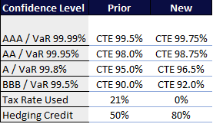
Variable Annuities
Substantial changes to VA risk charges
Increased CTE levels
No longer reduced for after-tax effect
Increased maximum hedging credit from 50% to 80%
Risk charges continue to differ from AM Best and RBC
No diversification credit against other risk categories
Maximum hedging credit still much lower than NAIC 95%
Removal of tax effect adds to capital volatility
S&P VA risk charges continue to be higher and more volatile
Notes:
Explain the Best Efforts vs Adjusted level

Slide 24
Diversification
Section 4

Slide 25
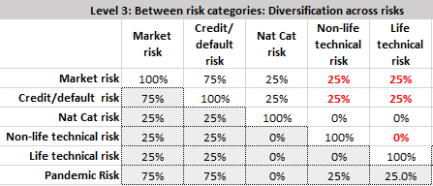
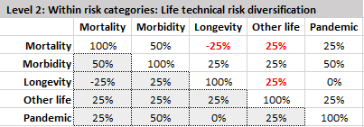
Diversification Correlation Matrices
Significant diversification benefits available between investment and liability risks
Different correlations than AM Best & NAIC RBC
Larger benefit to Life and Interest Rate risks (“C3int”)
Smaller benefit to equity risk (“C1cs”)
No credit to VA (“C3Mkt”)
Credit for Life & Non-Life
Haircut to diversification credit applied at each VaR level
Notes:
Complicated calculation
Three levels of diversification
Covariance factors by multiple risk categories
Haircut on aggregate diversification
Material update to model, especially compared to prior model
Compare against NAIC RBC and AM Best - Major Differences
Complexity
VA gets no diversification treatment
P&C is included
Similarities
Significant diversification for non-VA liability risks (mortality, longevity, reserve risks)
Need to allocate diversification back to risk drivers for capital analysis

Slide 26
Diversification Allocation
Diversification needs to be allocated for management decision making exercises such as product pricing and portfolio management
I recommend a ‘dollar diversification factor allocation’ methodology, akin to hedging greeks
For each risk factor calculate (A – B) / C where
C = Amount of pre-diversification required capital added
(A – B) = Impact on after-diversification required capital
Useful for internal incremental analysis, less useful for large scale restructures or M&A

Slide 27
Diversification Allocation Illustrative example
Assumed rating group has annuity, life insurance and P&C exposures
Category | Risk Capital | Pct of Total
Credit risk | 46,946 | 47%
Equity | 8,732 | 9%
Interest Rate | 30,369 | 30%
Asset Risks Subtotal | 86,047 | 86%
Other life | 10,292 | 10%
Mortality | 4,539 | 5%
Longevity | 7,709 | 8%
Non-life technical risk | 7,261 | 7%
VA | 9,365 | 9%
Liability Risk Subtotal | 39,166 | 39%
Diversification | -25,213 | -25%
Total | 100,000 | 100%

Slide 28
Diversification Allocation Illustrative example
Develop diversification factors by adding an amount to each risk category and calculating the percentage increase in the diversified required capital
Div Category | Undiversified Impact | Diversified Risk Charge | Diversified Impact | Diversification Factor
Baseline | 0 | 100,000 | 0 | 100%
Credit risk | 1,000 | 100,950 | 950 | 95%
Equity | 1,000 | 100,686 | 686 | 69%
Interest Rate | 1,000 | 100,906 | 906 | 91%
Other life | 1,000 | 100,498 | 498 | 50%
Mortality | 1,000 | 100,316 | 316 | 32%
Longevity | 1,000 | 100,405 | 405 | 40%
Non-life technical risk | 1,000 | 100,439 | 439 | 44%
VA | 1,000 | 101,000 | 1,000 | 100%

Slide 29
Diversification Allocation Illustrative example
Allocate the diversification benefit up to underlying risk drivers
Category | Risk Capital | Pct of Total | Div Allocation Factor | Div Allocated Risk Capital | Div Allocated Pct of Total
Credit risk | 46,946 | 47% | 95% | 44,585 | 45%
Equity | 8,732 | 9% | 69% | 5,994 | 6%
Interest Rate | 30,369 | 30% | 91% | 27,518 | 28%
Asset Risks Subtotal | 86,047 | 86% |  | 78,096 | 78%
Other life | 10,292 | 10% | 50% | 5,125 | 5%
Mortality | 4,539 | 5% | 32% | 1,432 | 1%
Longevity | 7,709 | 8% | 40% | 3,118 | 3%
Non-life technical risk | 7,261 | 7% | 44% | 3,190 | 3%
VA | 9,365 | 9% | 100% | 9,365 | 9%
Liability Risk Subtotal | 39,166 | 39% |  | 15,674 | 16%
Diversification | -25,213 | -25% | 1% | -327 | 0%
Total | 100,000 | 100% |  | 100,000 | 100%

Slide 30
Concluding Thoughts
Pros
Risk charges better aligned with underlying risk drivers
Guidance allows for model to adapt over time
Recognizes Life & Non-Life diversification
Completely transparent
Cons
Not enough guidance on implementation
Volatility of capital results

Slide 31
Questions?
Section 5

